Slide 1
Lowick Neighbourhood Plan
Jenny Ludman MRTPI
What you need to know….

Slide 2
Background
Localism act 2011
Give more power to local communities
Pro Development – not for preventing development!
Get the right kind of development in the right places
Voted on in a community referendum – more than 50% in favour and Plan is ‘made’ and becomes part of the development plan for the area
Being part of the development plan means it is the policy document that the planners look at first, when making decisions on planning applications – so very important!

Slide 3
Why have a neighbourhood plan?
What are the issues facing your local community?
  Better design in new development? Better recognition of local heritage?
  Location/type/scale/density of new housing development?
  More affordable housing? Too many second homes? Local needs housing?
  Define settlement boundaries?
  Securing developer contributions?
  Allocating local green spaces?
  Protection of community assets?
  Sustainable development/sustainable communities?

Slide 4
Limitations…
NPs are land-use planning documents - many matters cannot be dealt with through neighbourhood plans (e.g. most transport matters, litter, quality of roads, etc.)
your plan must be in conformity with strategic planning policy (NCC Core strategy) and with the NPPF (National Planning Policy Framework)
Your plan cannot deal with ‘strategic matters’
Your plan should not be a vehicle to prevent development

Slide 5
Process of production defined by the neighbourhood planning regs…
Define neighbourhood plan area (already done)
Consult community and other consultees on ‘pre-submission draft plan’ which has been produced in consultation with the local community/stakeholders (6 weeks)
Amend, and submit to LPA who consult again (6 weeks)
Examiner appointed and plan ‘examined; to check plan meets ‘basic conditions’
Modifications are made where necessary
Referendum
Plan made and becomes part of the statutory development plan for the area

Slide 6
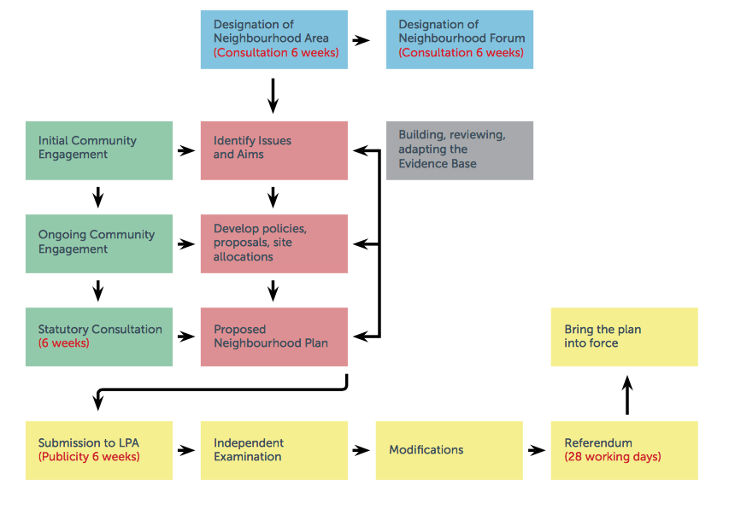

Slide 7
Sounds simple… the truth?
Form a Steering Group comprising a mix of local representation
Develop an engagement /consultation strategy (identify who you will consult, when, how)
Project plan
Initial ‘broad brush’ consultation with local community/businesses/land owners
Define a ‘Vision’ and ‘Objectives’ for the area based on initial consultation
Consult on these?
Identify policy areas – how will these meet the objectives?
Compile/gather a robust Evidence Base to support policies
Draft planning policies
Produce a draft plan and consult again?
Re-drafting of plan following consultations
Pre-submission draft plan consultation (1st statutory stage in the process)

Slide 8
Steering Group
Ensure your group members are aware of the time commitment – 2 – 3 years on average to produce a NP
Ensure you have a good mix from the local community representing a wide range of interests
Have a clear ‘Terms of Reference’ for your Steering Group and ensure good links with Qualifying Body (Parish Council)
Be transparent – post minutes on website – keep website up to date

Slide 9
Project Planning
Have a realistic project plan
Include Statutory Milestones
other stages of work (e.g. evidence base gathering, consultation events, stages of development)
Regularly review/update project plan

Slide 10
Consultation
Have a ‘Consultation Strategy’ that identifies who you are going to consult, at what stages, and how
Early consultation vital (use any existing information you have already e.g. parish plans)
Keep the first stages of consultation ‘open’ – what is good/bad/needs improvement in the area?
Ensure you reach out to all sectors of the community, including ‘hard to reach’ groups
Keep records of responses, and how important different issues were to different sectors of the community
Next stages of consultation, ensure you consult with statutory consultees other Schedule 1 consultees

Slide 11
Define a vision
Use your consultation responses to build a picture of what it is that you want to achieve through the plan
Be brief, but try and keep it clear, so objectives can be defined that meet that vision
Consult on your vision/objectives if necessary
e.g. Allendale vision states:
“A group of sustainable, vibrant, linked rural communities focussed around a strong service centre at Allendale Town, adapting to the changing needs of our population.”

Slide 12
DEFINE OBJECTIVES
Objectives should be clearly linked to the ‘Vision’
Often theme based (heritage, housing, local economy etc.)
Be clear about what they are trying to achieve so that planning policies can emerge from the objectives

Slide 13
Define policy areas/policies
Define specific policy areas or projects needed to achieve each objective. Define what the intention of that policy would be.
Ensure you have the evidence to support your policy approach and that a robust methodology has been used to gather evidence.
Finally, draft policies, and make sure they meet the policy intention.
Test your policies to make sure they achieve what you want them to achieve, and to make sure that they meet the ‘basic conditions’.

Slide 14
Submission of Plan to LPA
Pre-submission draft plan which has been consulted on (and where necessary amended)
‘Basic Conditions’ Statement
‘Consultation’ Statement
Evidence Base documents

Slide 15
What are the basic conditions?
The basic conditions are set out in paragraph 8(2) of schedule 4B to the town and country planning act 1990. Essentially they require that neighbourhood plans:
  • are prepared having regard to national policy and guidance (NPPF and NPPG);
  •are in general conformity with the strategic policies in the development plan;
  •contribute to the achievement of sustainable development; and
  •are compatible with European Union obligations on environmental impact and human rights.

Slide 16
Finally… Do’s and don’ts!
DO ensure clear terms of reference for steering group if delegated by Parish Council
DO have a Steering Group with broad local representation
DO define clear Vision and Objectives early on, following meaningful consultation
DO consult with all sectors of your community and make sure at all times that you are working with your community
DO ensure your plan is evidence based. Opinions are important, but your policy approach must be evidence based
DO ensure that your plan is in conformity with the strategic plan for your area
DO be transparent – keep all minutes/information/evidence/consultation results on a website
DO work closely with your NCC link officer – planning advice/strategic planning policy/SEA advice etc.

Slide 17
Finally… DO’s and don’ts
DON’T try and cover everything in your plan – stick to the issues that matter to your community
DON’T start drafting policies too early – policies should be based on clear vision and objectives established early on in the process through community/stakeholder consultation
DON’T leave out people in the community/other stakeholders – be inclusive
DON’T try and cover matters that cannot be dealt with through neighbourhood planning (i.e. strategic matters)
DON’T forget this is a plan by the community, for the community and it gets voted on! Make sure you don’t lose sight of what the community want.

Slide 18
Resources
Cost of producing a plan in terms of money and time should not be underestimated
Locality funding (£8,000 available)
Specialist advice (if needed), other costs (printing/consultation events/room hire etc..)
Make the most of free resources: NCC Council link officer, evidence already available at NCC etc.
Online resources – ‘Locality’ and ‘Planning Aid’ have useful web based resources for Neighbourhood Planning
Look at other adopted Neighbourhood Plans

